Slide 1
EduPredict AI Student Performance Prediction & Academic Risk Analysis System An End-to-End Data Science and Machine Learning Solution
Developed by
P. Naresh
Saveetha University, Chennai
Academic Year: 2026–2027

Slide 2
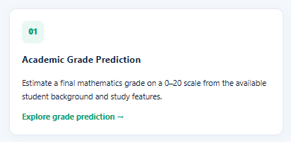
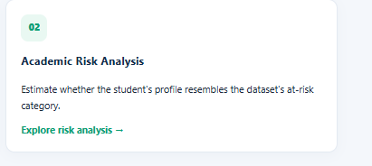
Project Overview
Grade Prediction: Predict students' expected academic grades using Machine Learning.
Academic Risk Analysis: Identify students who may need additional academic support.
Data Analysis: Analyse attendance, study habits and other student-related factors.
Web Application: Provide predictions through a user-friendly Flask application.
Main Technologies:
Python
Pandas and NumPy
Matplotlib and Seaborn
Scikit-learn
SHAP
Flask

Slide 3
Problem Statement
Identifying weak students at an early stage is difficult.
Traditional methods cannot easily predict future academic performance.
Student data is not always properly analysed.
Students may not receive timely academic support

Slide 4
Project Objectives
Collect and understand student performance data.
Clean and preprocess the dataset.
Perform Exploratory Data Analysis (EDA).
Apply Machine Learning algorithms.
Predict student grades and academic risks.
Evaluate and optimize model performance.
Deploy the model using Flask.

Slide 5
Dataset & Data Understanding
Dataset Source: UCI Machine Learning Repository.
Dataset Name: Student Performance Dataset.
Contains student academic and personal information.
Includes study time, absences and family-related factors.
Used to analyse student performance.
Helps predict final grades and academic risks.
Dataset Link: https://archive.ics.uci.edu/dataset/320/student+performance

Slide 6
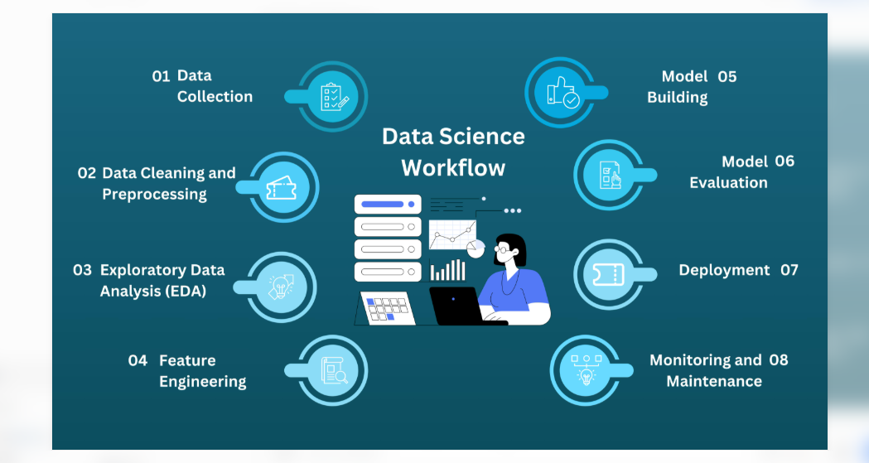
Project Methodology

Slide 7
Exploratory Data Analysis (EDA) & Feature Engineering
Analyse student performance data.
Identify important features.
Study attendance and marks.
Find relationships between variables.
Create useful features for Machine Learning.
Visualize data using graphs and charts.

Slide 8
Model Development & Comparison
Machine Learning Models:
Linear Regression
Random Forest
Gradient Boosting
Logistic Regression
Compare different ML algorithms.
Select the best-performing model.
Evaluation Metrics:
MAE
RMSE
R² Score
Accuracy
F1-Score

Slide 9
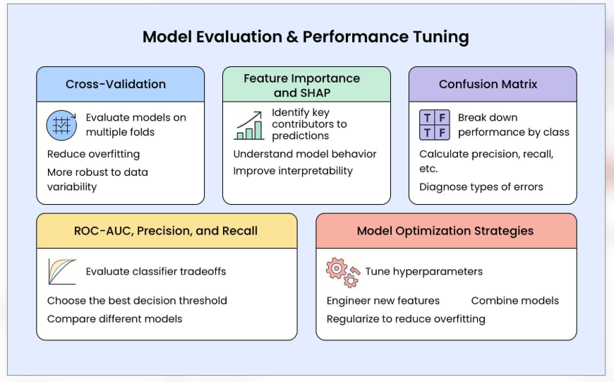
Model Evaluation & Optimization
Evaluate model performance.
Apply K-Fold Cross-Validation.
Use Randomized SearchCV for hyperparameter tuning.
Improve model performance.
Compare prediction results.
Select the best optimized model.

Slide 10
Model Performance Results
Grade Prediction (Regression)
MAE: 2.9086
RMSE: 3.9802
R² Score: 0.2516
Academic Risk Prediction (Classification)
Accuracy: 75.95%
F1-Score: 57.78%
ROC-AUC: 75.83%

Slide 11
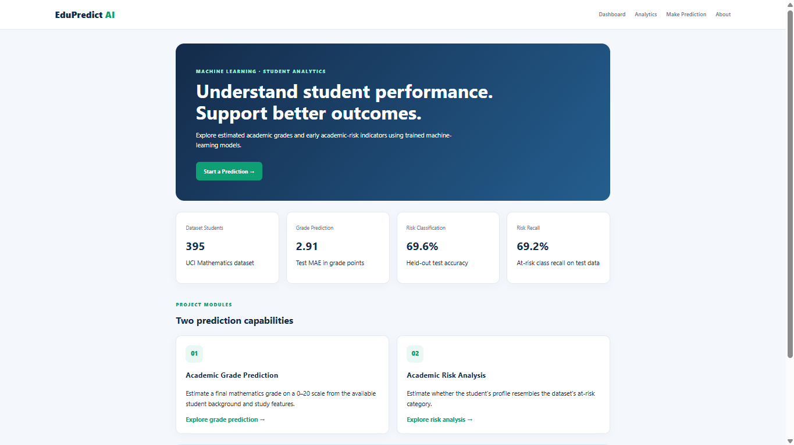

Slide 12
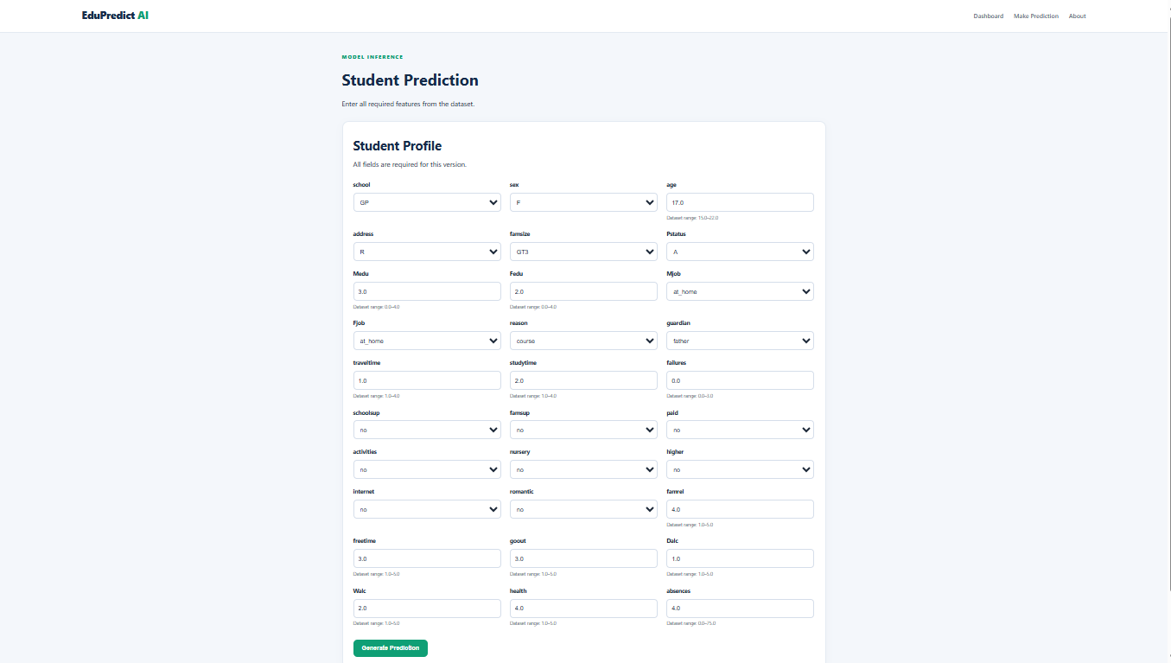

Slide 13
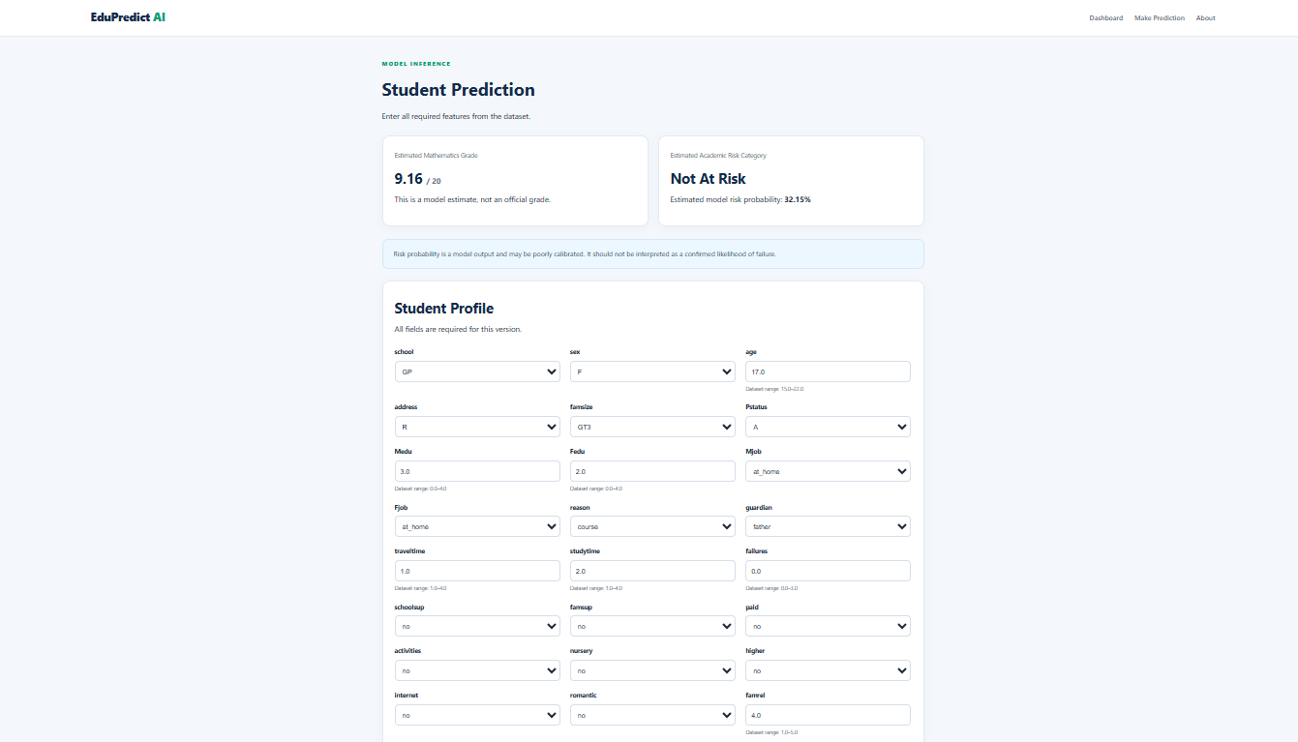

Slide 14
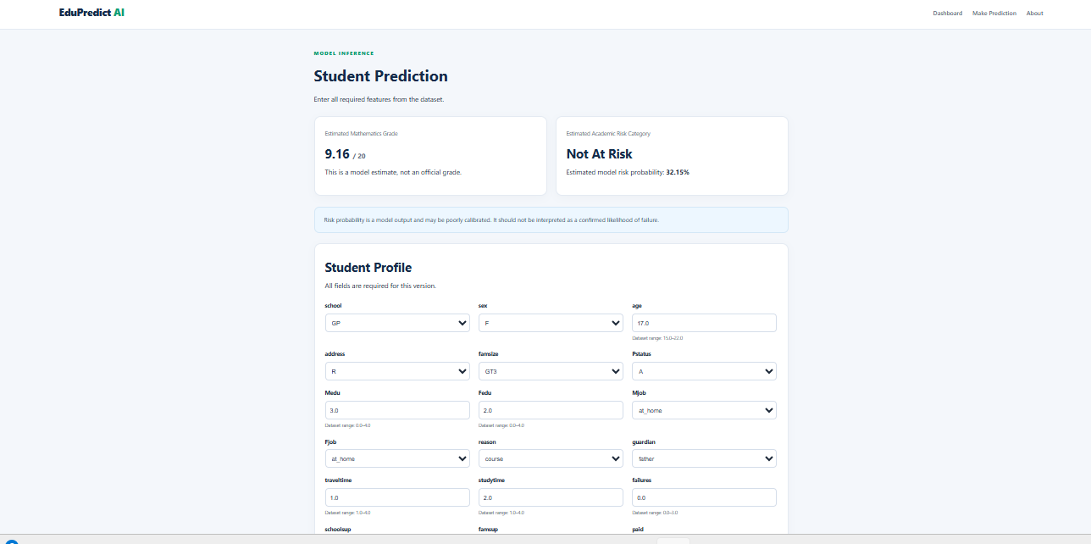

Slide 15
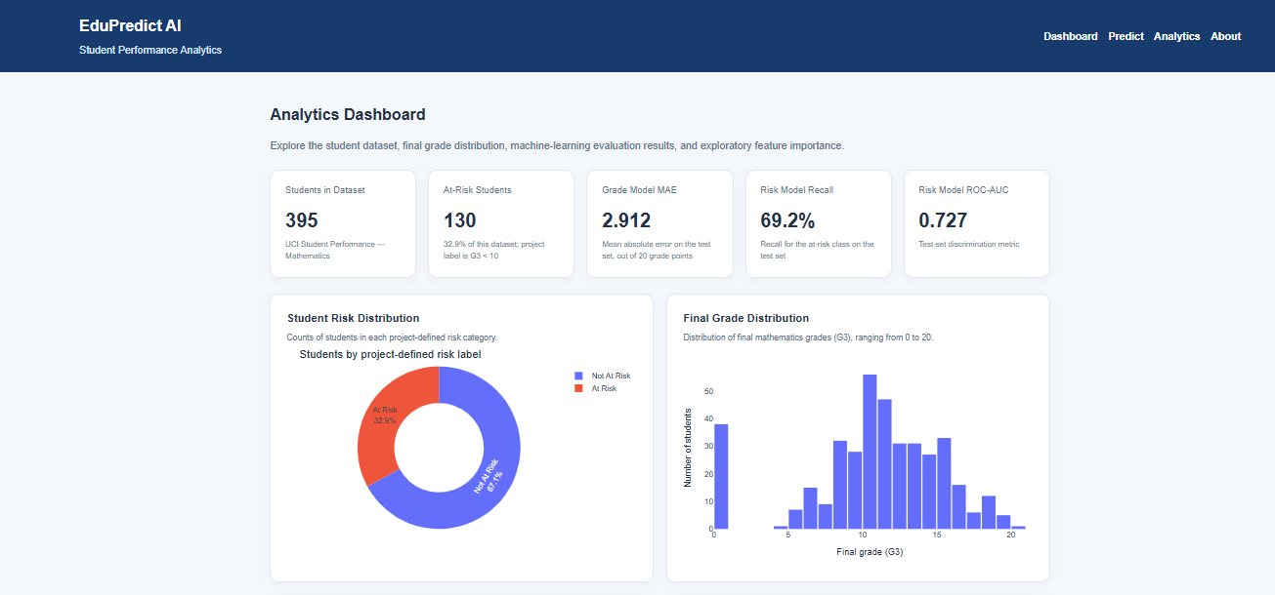

Slide 16
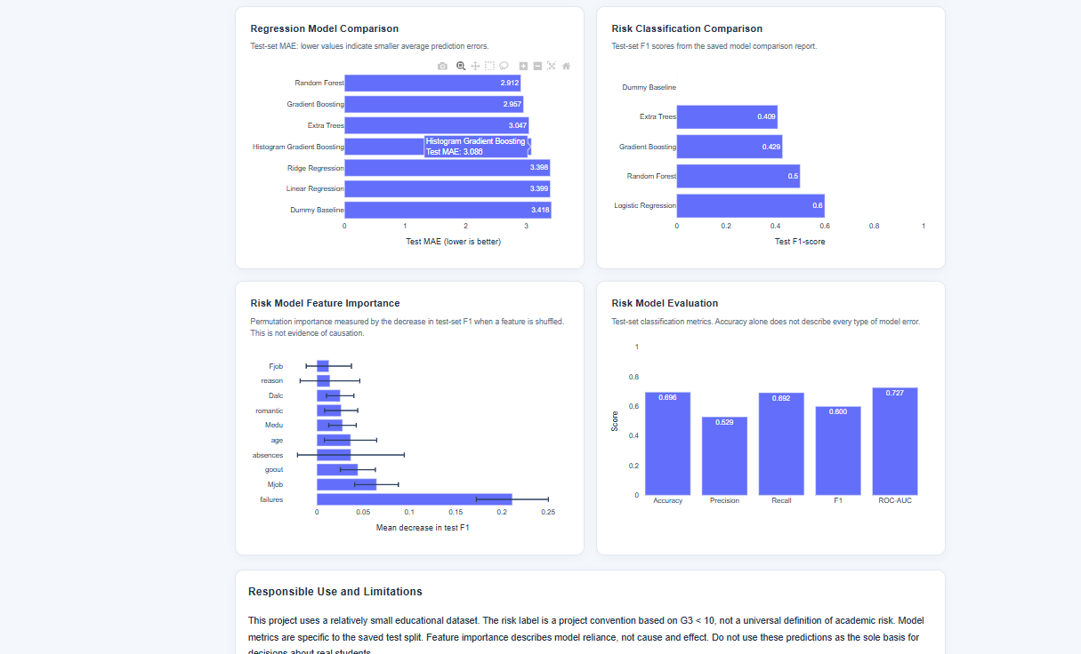

Slide 17
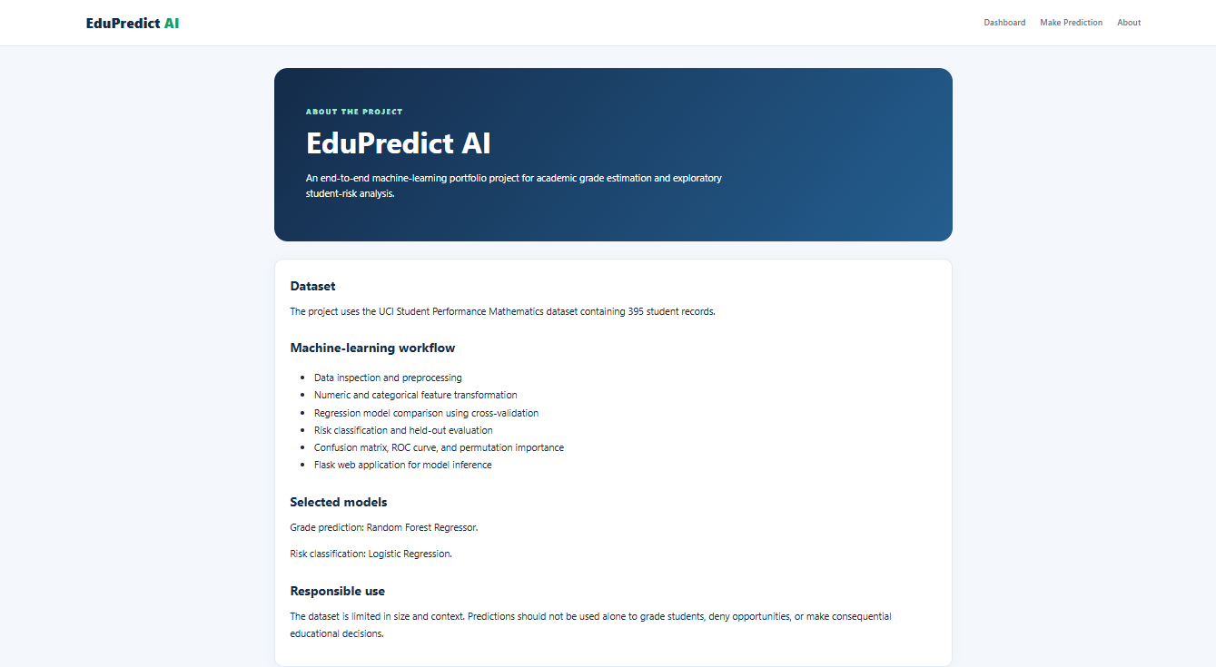

Slide 18
Model Explainability & Deployment
Use feature importance to identify important student factors.
Use SHAP to explain model predictions.
Develop a web application using Flask.
Enter student details through a web form.
Display predicted grades and academic-risk results.
Make predictions easy to understand.

Slide 19
Conclusion
Student performance dataset
Python source code and Jupyter notebooks
Data preprocessing and EDA charts
Trained machine learning models
Model evaluation and optimization results
SHAP explainability results
Flask web application
README and project documentation

Slide 20


